Slide 1
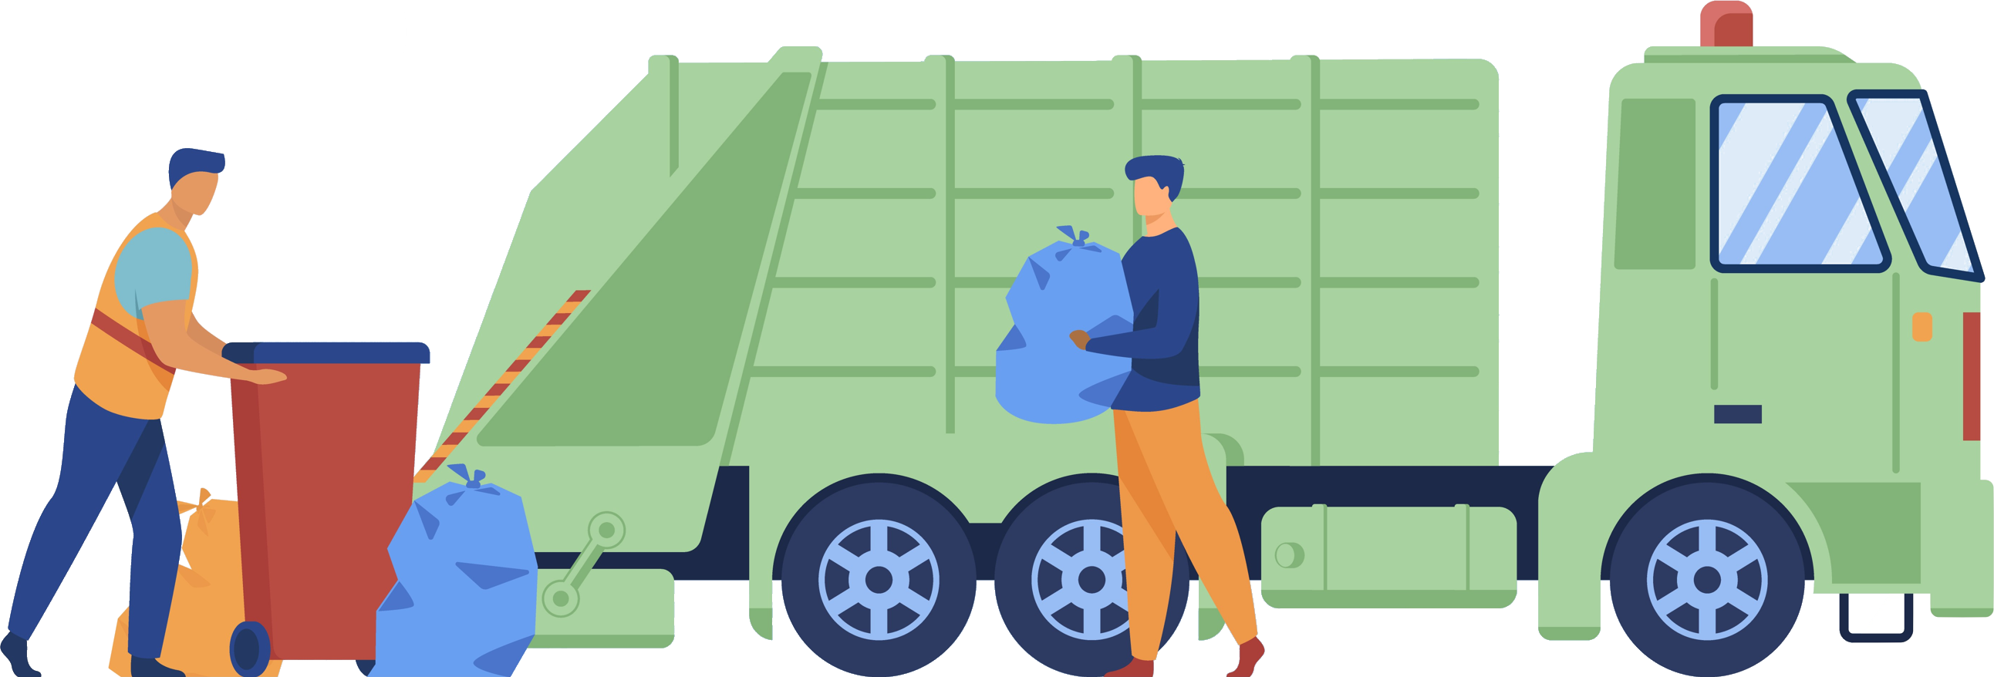
Pitch Stadt St. Gallen
Team unkrETHiv

Slide 2
Problems
Solutions
Buying stickers is a hassle and too complicated
Confusion leads to administrative burden and incorrect disposal
→ Make it simple and frictionless
→ Inform and support citizens
Notes:
Buying bulky item stickers is a hassle and too complicated for customers. Confusion about how many stamps (maybe also where with map? Though already solved) an item exactly needs leads to frustration and extra work for both customers and administration.
969 illegal cases of bulky waste disposal in 2022
1238 correct cases of bulky waste disposal in 2022

Slide 3
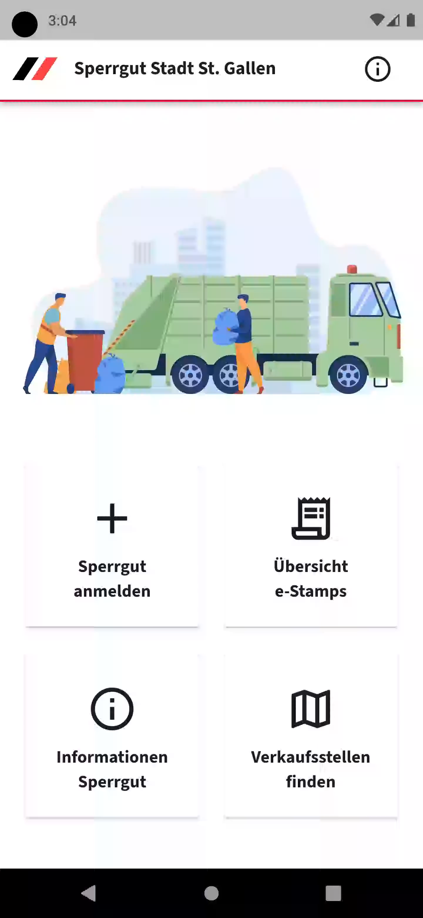
Our Result
App for Citizens

Slide 4
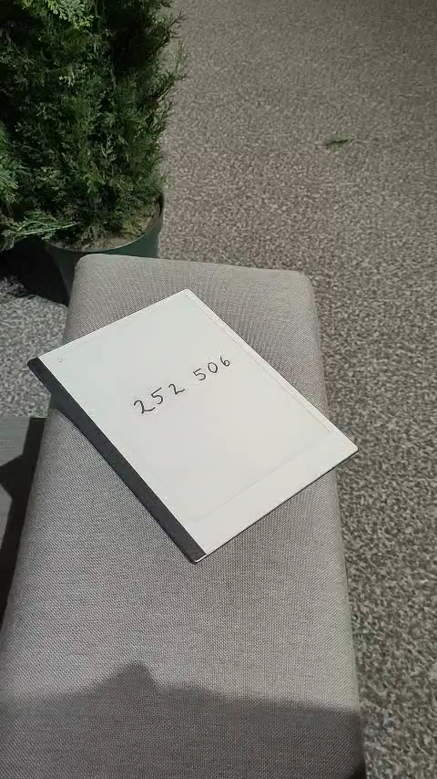
Our Result
App for Collectors

Slide 5








Our Focus
Keeping it simple Accessible on all platforms
Data protection Backwards Compatibility
Notes:
Data protection: a person using the app should in no way be worse off than someone analogously

Slide 6
THANKS
Notes:
Data protection: a person using the app should in no way be worse off than someone analogously

